Slide 1






E-COMMERCE SALES ANALYSIS
Project Title
Name : AJITH KUMAR S
Email id : seenivasanajith123@gmail.com Guide: RAJA P
Disclaimer: The content is curated for educational purposes only.

Slide 2
OUTLINE
Project Title
Abstract of the Project
Problem Statement
Proposed Solution
System Architecture
Live Demo of the Project
Embedded Video of Project
Conclusion
Future Scope

Slide 3
Project Title
Abstract
The e-commerce industry has experienced remarkable growth, transforming the way consumers shop and businesses sell. This analysis delves into e-commerce sales patterns, consumer behavior, and market trends to provide insights that can guide strategic business decisions. By examining data on sales volume, customer demographics, purchasing frequency, and seasonality, we aim to understand the factors driving online sales and customer engagement. The study also addresses how promotions, discounts, and various product categories impact revenue, highlighting which strategies and categories yield the highest returns. Furthermore, we consider the role of emerging technologies like artificial intelligence and machine learning in enhancing customer experience, personalizing recommendations, and predicting purchasing trends. This analysis is particularly valuable for businesses looking to optimize their online presence and adapt to rapidly changing consumer preferences. The findings offer actionable insights for enhancing marketing approaches, improving product offerings, and refining inventory management, ultimately supporting sustained e-commerce growth and profitability.

Slide 4
Project Title
Problem Statement
In the rapidly growing e-commerce industry, businesses are generating massive amounts of sales data every day. However, many companies struggle to turn this data into actionable insights. Analyzing sales data can provide valuable insights into customer preferences, seasonal trends, best-selling products, and revenue drivers. The challenge lies in efficiently processing, analyzing, and visualizing this large volume of data to uncover patterns and make data-driven decisions.
This project aims to develop an e-commerce sales analysis solution that helps companies make informed decisions. Key objectives include identifying top-selling products, understanding customer purchase behavior, tracking sales trends over time, and evaluating marketing campaign effectiveness. Additionally, it should identify factors influencing customer churn and retention, optimize inventory management, and highlight high-potential market segments.
By implementing advanced data analytics and visualization techniques, this solution will empower businesses to optimize their strategies, boost customer satisfaction, and increase profitability.

Slide 5
Project Title
Proposed Solution
A solution for an **e-commerce sales analysis** system would involve leveraging data-driven insights to improve sales, customer experience, and operational efficiency. The system can be designed to gather, process, and analyze data from various sources, such as customer transactions, website traffic, and inventory status. Using technologies like Python, SQL, and analytics tools, it can generate detailed reports and visualizations on sales trends, top-selling products, and customer preferences.
To implement this, we propose building a data pipeline that automates data collection and cleaning, followed by storing it in a structured database like MySQL. For analysis, machine learning models could be applied to forecast future sales and identify potential churn risks among customers. Additionally, data visualization tools (e.g., Tableau or Power BI) could be used to create interactive dashboards for easy interpretation.
This solution can support business decisions on inventory management, marketing strategies, and customer engagement, ultimately aiming to optimize sales performance and customer satisfaction.

Slide 6
Project Title
System Architecture
The system architecture for an e-commerce sales analysis platform generally follows a multi-layered approach to handle data collection, processing, and visualization.
Data Collection Layer: This layer gathers data from various sources, including sales transactions, customer profiles, product information, and browsing patterns. Data sources include databases, APIs, and third-party integrations.
Data Storage Layer: Here, a data warehouse or cloud storage solution (e.g., AWS, Google BigQuery) stores collected data. This ensures data persistence, scalability, and accessibility for large volumes of historical data.
Data Processing and Analytics Layer: This is the core of sales analysis. ETL (Extract, Transform, Load) processes clean,
aggregate, and transform raw data. Then, analytics tools and machine learning models analyze sales trends, customer behavior, and inventory metrics. Apache Spark, Hadoop, or similar frameworks often support large-scale processing.
By integrating these layers, an e-commerce sales analysis architecture can efficiently process and present data, enabling insightful decision-making.

Slide 7
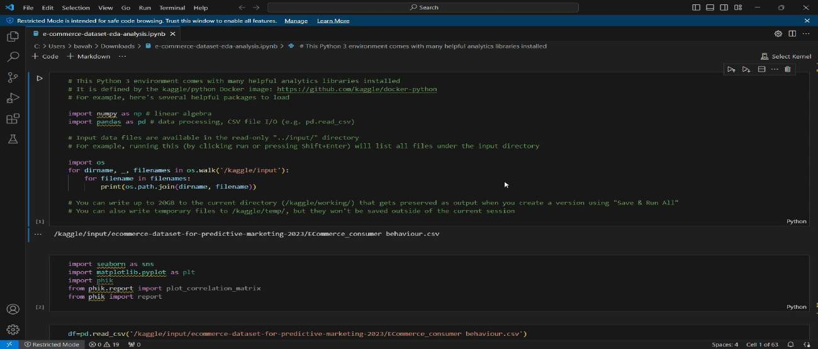
Live Demo of Project
Project Title

Slide 8
Conclusion
In conclusion, the e-commerce sales analysis offers valuable insights into consumer behavior, seasonal trends, and product preferences, essential for informed decision-making. By examining key metrics such as sales volume, customer acquisition costs, and conversion rates, businesses can pinpoint areas for improvement and capitalize on high-demand periods. The analysis highlights that targeted marketing and personalization, alongside inventory optimization, play crucial roles in boosting sales performance. Additionally, emerging trends like mobile shopping and social media influence underscore the importance of adapting strategies to evolving consumer preferences. This data-driven approach not only enhances customer satisfaction but also improves operational efficiency, driving sustainable growth and profitability in the competitive e-commerce market.
Project Title

Slide 9
Project Title
Future Scope
The future scope of e-commerce sales analysis is broad, driven by rapid advancements in technology and shifts in consumer behavior. As e-commerce continues to grow, businesses are increasingly relying on sales analysis to make informed decisions. In the future, more sophisticated AI and machine learning algorithms will enhance the accuracy of predictive models, helping businesses forecast demand, personalize customer experiences, and optimize pricing strategies. Real-time analytics will allow companies to adjust to market changes instantly, adapting promotions, stock levels, and marketing approaches to consumer preferences. Additionally, integrating data from multiple channels, including social media, mobile apps, and physical stores, will provide a more holistic view of consumer behavior.
With growing focus on data privacy and security, future analytics tools will also need to incorporate advanced encryption and compliance with data protection laws, making customer data management more secure. Enhanced data visualization tools will make complex insights more accessible for strategic planning. This evolution in e-commerce sales analysis will help businesses stay competitive by enabling more agile, data-driven decision-making.

Slide 10
Thank you!
Project Title

